Slide 1

Project Presentation on “PHISHING URL DETECTION USING MACHINE LEARNING” Department of computer science & engineering
Presented By:
Project Group (B. Tech CSE )
Miss. Anamika Dhananjay Gulumkar(2003)
Miss. Harshada Dattatray Jadhav(2017)
Miss. Sakshi Chandrashekar Shinde(2035)
Mr. Shridhar Prakash Aware(2042)
Guided By:
Guide Name:- Mr. Pathak P.A.
Designation:- Assistant Professor
College Name:- Arvind Gavali College Of Engineering , Satara

Slide 2
CONTENTS
INTRODUCTION
PROBLEM STATEMENT
OBJECTIVES OF THE PROPOSED WORK
LITERATURE REVIEW
METHODOLOGY
HARDWARE REQUIREMENTS
SOFTWARE REQUIREMENTS
RESULTS & DISCUSSIONS
CONCLUSIONS
FUTURE SCOPE
REFERENCES
PROGRAM OUTCOMES
COURSE OUTCOMES
CO-PO MAPPING

Slide 3
INTRODUCTION
Phishing via URLs (Uniform Resource Locators) is one of the most common types, and its primary goal is to steal the data from the user when the user accesses the malicious website.
A URL is a website address that represents the location of a website on a network and the means of gaining access to it.
The increasing use of the Internet has led to a new way of stealing data, known as cybercrime.
This work aims to provide a solution for detecting such websites with the help of machine learning algorithms.

Slide 4
PROBLEM STATEMENT
Detecting suspicious websites and detecting if they are phishing or not?

Slide 5
OBJECTIVE
Machine Learning is an effective method for detecting phishing.
It also eliminates the disadvantages of the previous method such as Phishtank.
We conducted a review of the literature and suggested a new method for detecting phishing websites using features extraction and a machine learning algorithm.
The project's goal is to detect phishing URLs and narrow down the best machine learning algorithm by evaluating each algorithm's accuracy rate, false positive rate, and false negative rate.

Slide 6
LITERATURE SURVEY
Author Name | Paper Name | Publication Year | Important Points
^{Prof. Shilpa Hadkar} | “Intelligent phishing URL detection using association rule mining” | 2022 | Aim of the paper is to detect phishing URLs as well as narrow down to best machine learning algorithm by comparing accuracy rate, false positive and false negative rate of each algorithm.
Mr. S.M. Mohammed Nazim Feroz | “Phishing URL detection using URL ranking” | 2019 | Aim of the phishers is to acquire critical information like username, password and bank account details. Cyber security persons are now looking for trustworthy and steady detection techniques for phishing websites detection.
Mr. Rishikesh Mahajan | “Phishing Website Detection using Machine Learning Algorithms” | 2018 | This paper deals with machine learning technology for detection of phishing URLs by extracting and analyzing various features of legitimate and phishing URLs. Decision Tree, random forest and Support vector machine algorithms are used to detect phishing websites.

Slide 7
Author Name | Paper Name | Publication Year | Important Points
Mr. B. B. Gupta | “PHISH-SAFE: URL features-based Phishing detection system using Machine learning” | 2018 | PHISH-SAFE, a machine learning-based anti-phishing system, uses 14 URL features to detect phishing websites. Trained on over 33,000 URLs with SVM and Naïve Bayes classifiers, the system achieved over 90% accuracy using the SVM classifier.
Mr. Ali Bostani | “ Machine Learning Model for Phishing URL Detection ” | 2017 | An experimental study shows that data balancing, hyperparameter optimization, and feature selection significantly enhance the accuracy of models, with Random Forest and Gradient Boosting achieving over 97% accuracy on two common phishing datasets.

Slide 8
EXISTING SYSTEM
PhishNet: Combines lexical and host-based features to classify URLs using machine learning algorithms.
PhishGuard: Employs heuristic rules and machine learning to identify phishing URLs based on URL and domain characteristics.
PUFS (Phishing URL Feature-based System): Leverages various URL and domain features, applying machine learning models for classification.
DeepPhish: Utilizes deep learning with Convolutional Neural Networks (CNNs) to analyze URL structures and webpage content for phishing detection.
CANTINA: Uses TF-IDF (term frequency – Inverse document frequency) for keyword frequency analysis in URLs and webpage content to detect phishing.

Slide 9
METHODOLOGY
Data Collection and Feature Extraction:
Collect labeled URLs (phishing and safe).
Extract relevant features (URL length, special characters, subdomains, etc.).
Model Training and Evaluation:
Train machine learning models (e.g., Logistic Regression) on the dataset.
Integration and Deployment:
Develop a user interface for URL input and display the safety prediction.
Continuous Monitoring and Improvement:
Regularly update the model with new data to maintain accuracy.

Slide 10
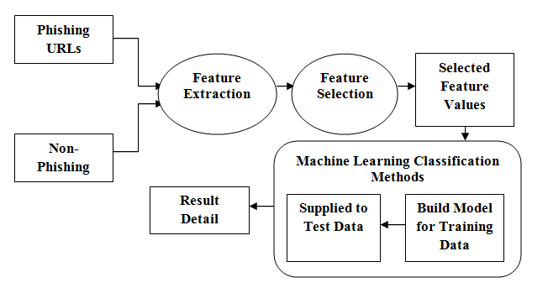
BLOCK DIAGRAM

Slide 11
HARDWARE AND SOFTWARE REQUIREMENTS
Hardware Required -
Server :
8 GB RAM
512 GB of SSD
Windows 11
Client :
8 GB RAM
100 GB of SSD
Windows 11

Slide 12
Software Requirement -
Development :
Anaconda Navigator
Data Set
Python 2.7
Libraries :
Pandas
Numpy
Sklearn

Slide 13
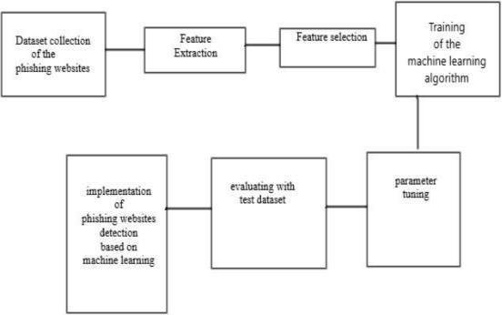
FLOWCHART DIAGRAM

Slide 14
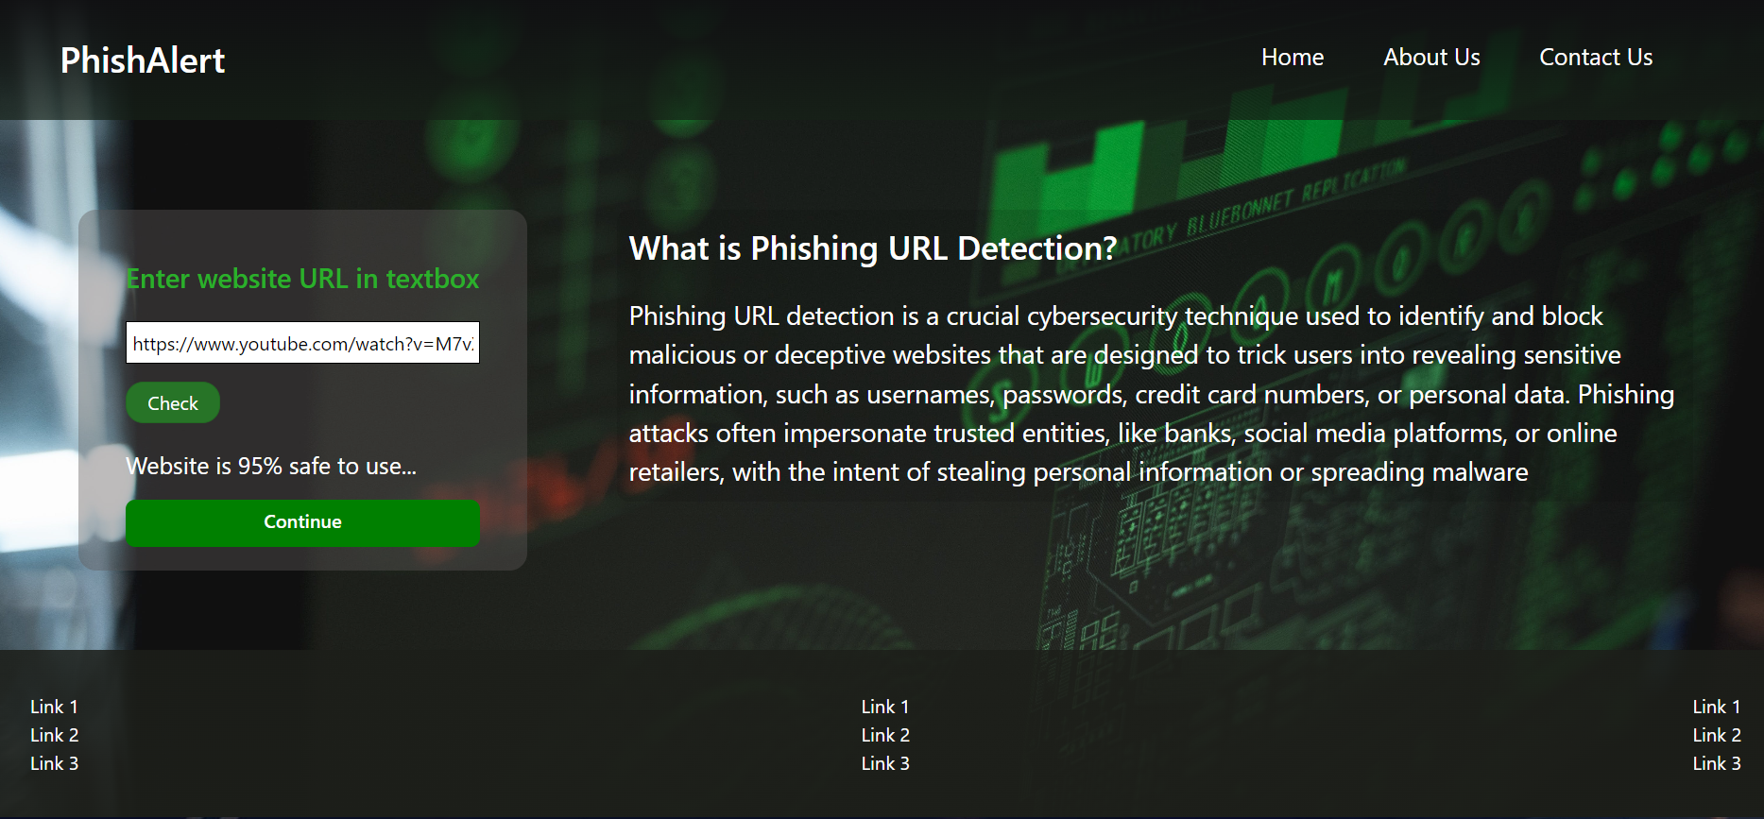
RESULT

Slide 15
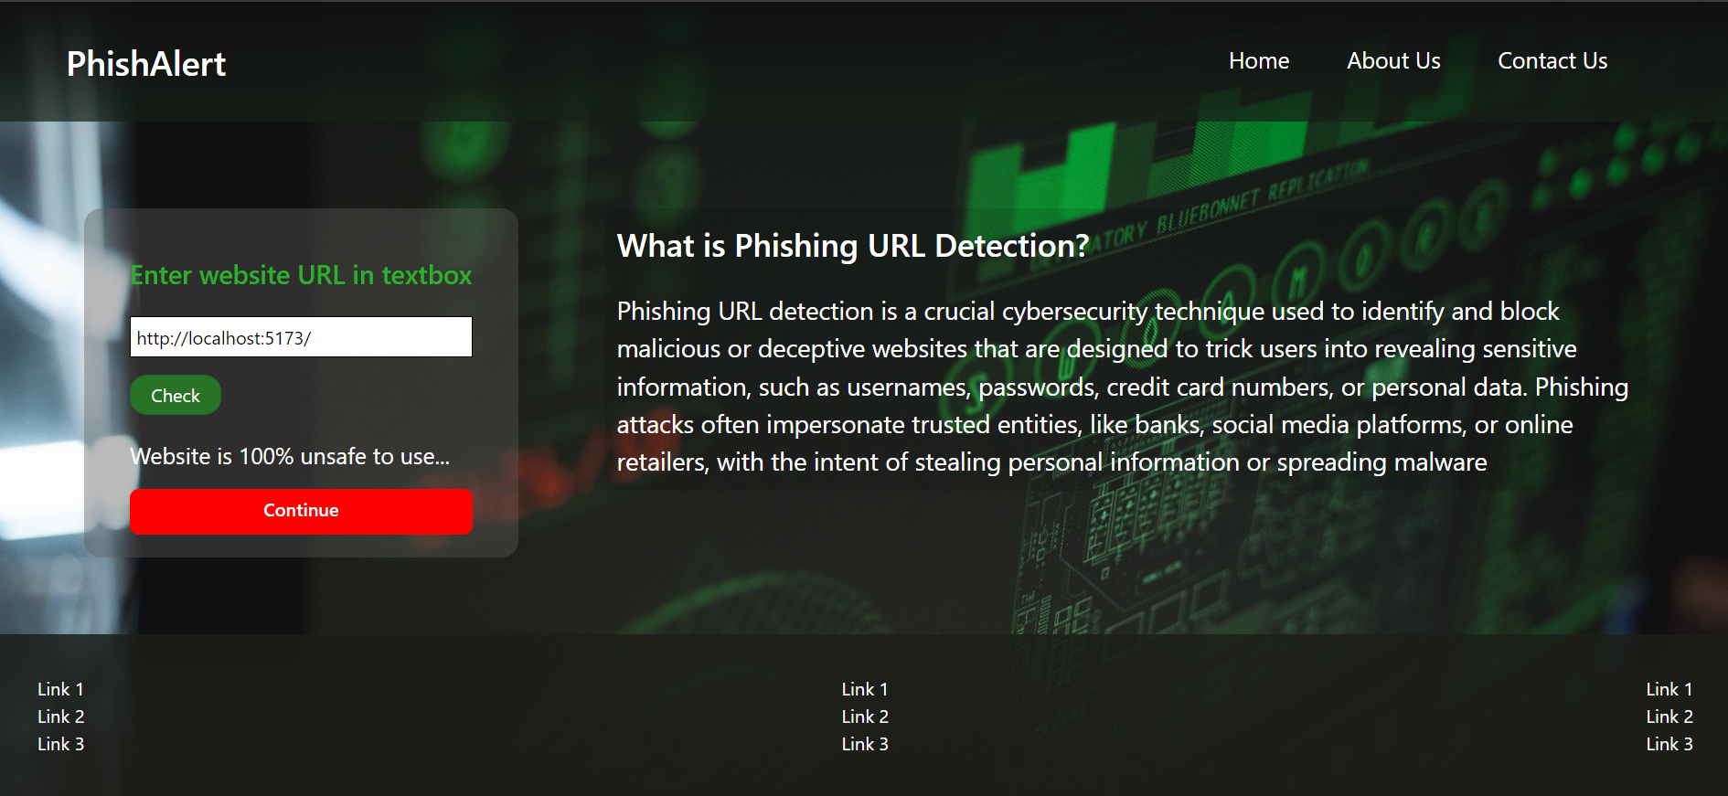

Slide 16
CONCLUSIONS
This survey presented various algorithms and approaches to detect phishing websites by several researchers in Machine Learning.
On reviewing the papers, we came to a conclusion that most of the work done by using familiar machine learning algorithms like Naïve Bayesian, SVM, Decision Tree and Random Forest.Some authors proposed a new system like Phish Score and Phish Checker for detection.
The combinations of features with regards to accuracy, precision, recall etc. were used. Experimentally successful techniques in detecting phishing website URLs were summarized.
As phishing websites increases day by day, some features may be included or replaced with new ones to detect them.

Slide 17
FUTURE SCOPE
In future if we get structured dataset of phishing we can perform phishing detection much more faster than any other technique.
In future we can use a combination of any other two or more classifier to get maximum accuracy.
We also plan to explore various phishing techniques that uses Lexical features, Network based features, Content based features, Webpage based features and HTML and JavaScript features of web pages which can improve the performance of the system.
In particular, we extract features from URLs and pass it through the various classifiers.

Slide 18
REFERENCES
[1] Gandotra, E., & Gupta, D. (2021). Improving spoofed website detection using machine learning. Cybernetics and Systems, 52(2), 169-190.
[2] Harinahalli Lokesh, G., & BoreGowda, G. (2021). Phishing website detection based on effective machine learning approach. Journal of Cyber Security Technology, 5(1), 1-14.
[3] Singh, C. (2020, March). Phishing website detection based on machine learning: A survey. In 2020 6th International Conference on Advanced Computing and Communication Systems (ICACCS) (pp. 398-404). IEEE.
[4] Patil, V., Thakkar, P., Shah, C., Bhat, T., & Godse, S. P. (2018, August). Detection and prevention of phishing websites using machine learning approach. In 2018 Fourth international conference on computing communication control and automation (ICCUBEA) (pp. 1-5). IEEE.
[5] Rasymas, T., & Dovydaitis, L. (2020). Detection of phishing URLs by using deep learning approach and multiple features combinations. Baltic journal of modern computing, 8(3), 471-483.

Slide 19

PROGRAM OUTCOMES

Slide 20
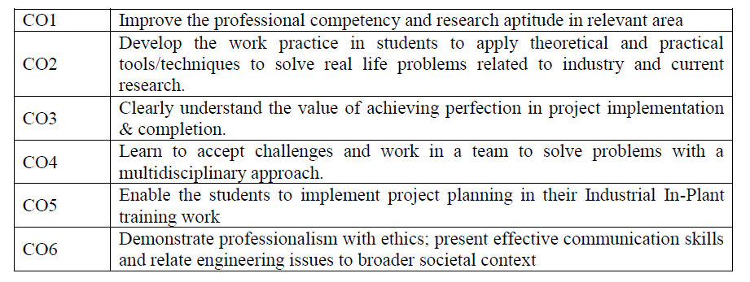
COURSE OUTCOMES OF PROJECT

Slide 21
CO-PO MAPPING OF PROJECT
 | PO 1 | PO 2 | PO 3 | PO 4 | PO 5 | PO 6 | PO 7 | PO 8 | PO 9 | PO 10 | PO 11 | PO 12
CO 1 | 3 | 3 | 2 | 3 | 2 | 3 | 3 | 2 | 2 | 3 | 3 | 2
CO 2 | 1 |  | 3 | 3 | 3 | 2 |  |  | 3 |  | 2
CO 3 | 2 | 2 | 3 |  |  |  |  | 3 | 3 |  | 3 | 3
CO 4 | 1 | 3 | 3 |  | 2 |  |  |  | 3 | 3 | 3 | 2
CO 5 | 3 | 3 | 3 | 3 | 3 | 3 | 3 | 2 | 3 | 3 | 3 | 3
CO 6 | 2 | 3 | 1 |  | 3 |  |  |  | 3 | 2 |  | 3
Strength of Correlation: High: 3 Medium: 2 Low: 1

Slide 22


